Slide 1
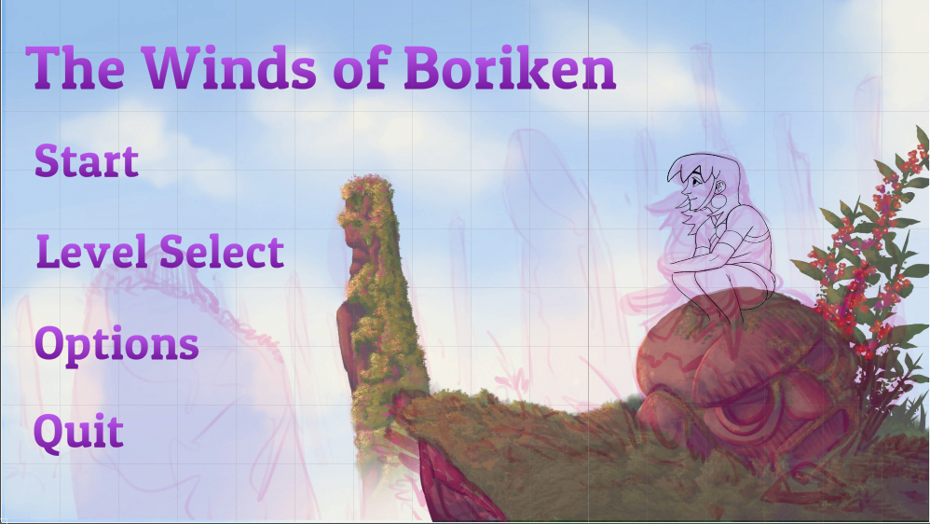
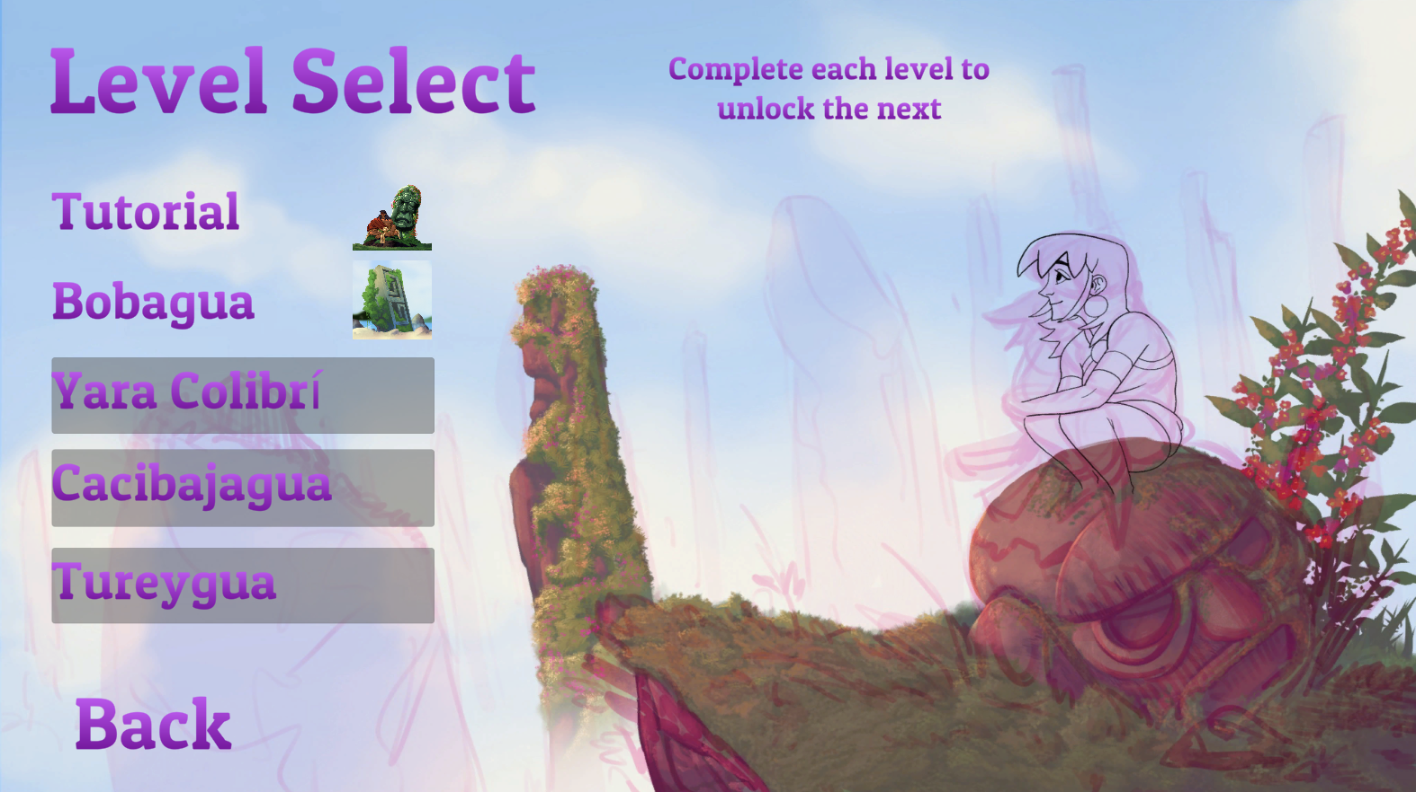
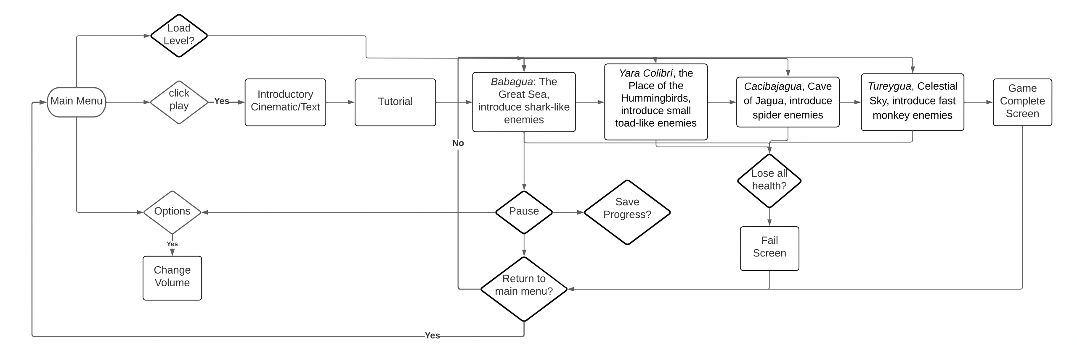
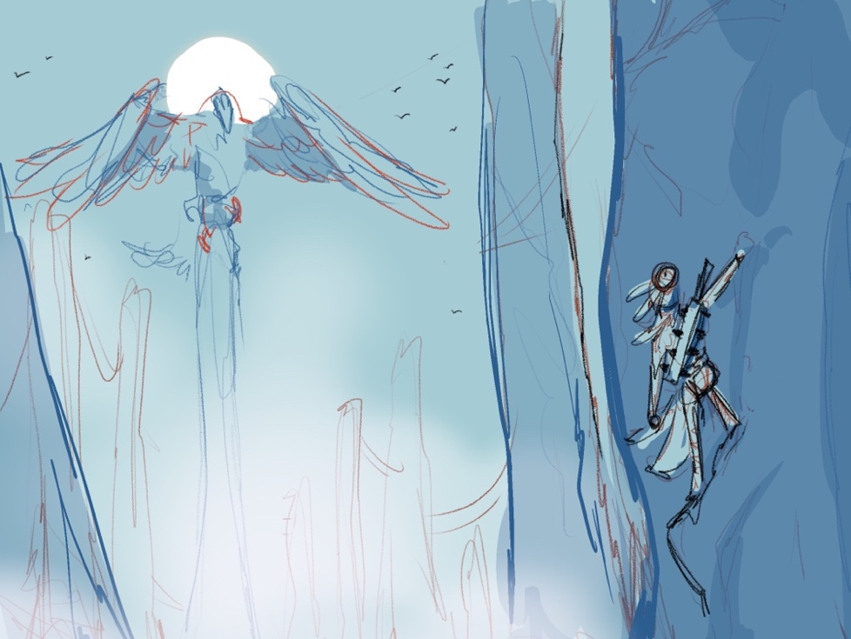
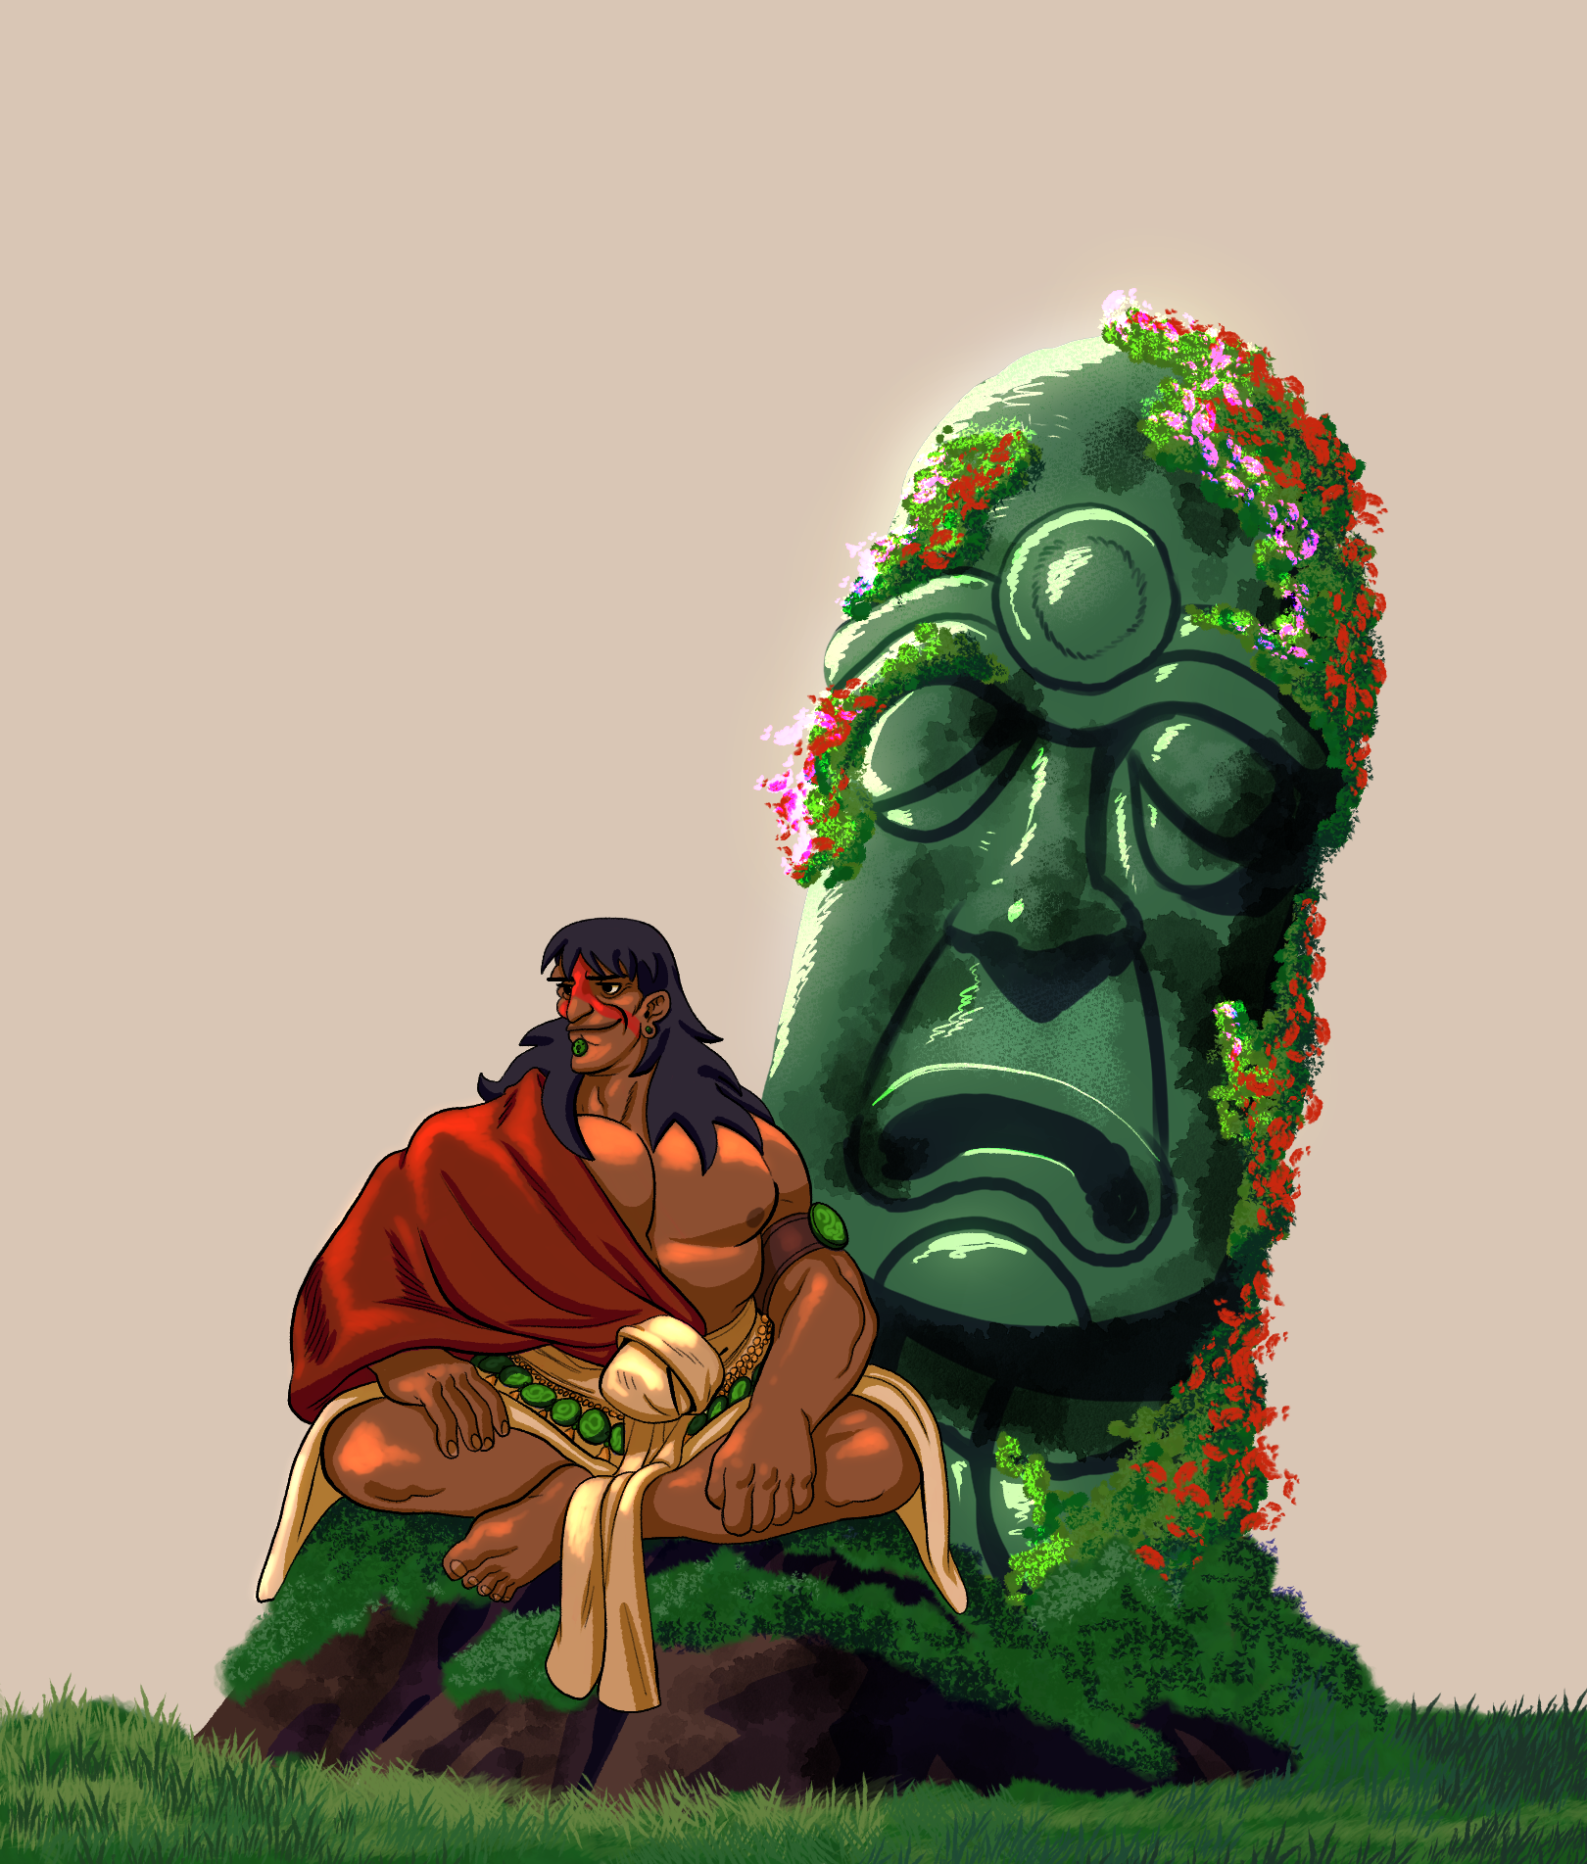
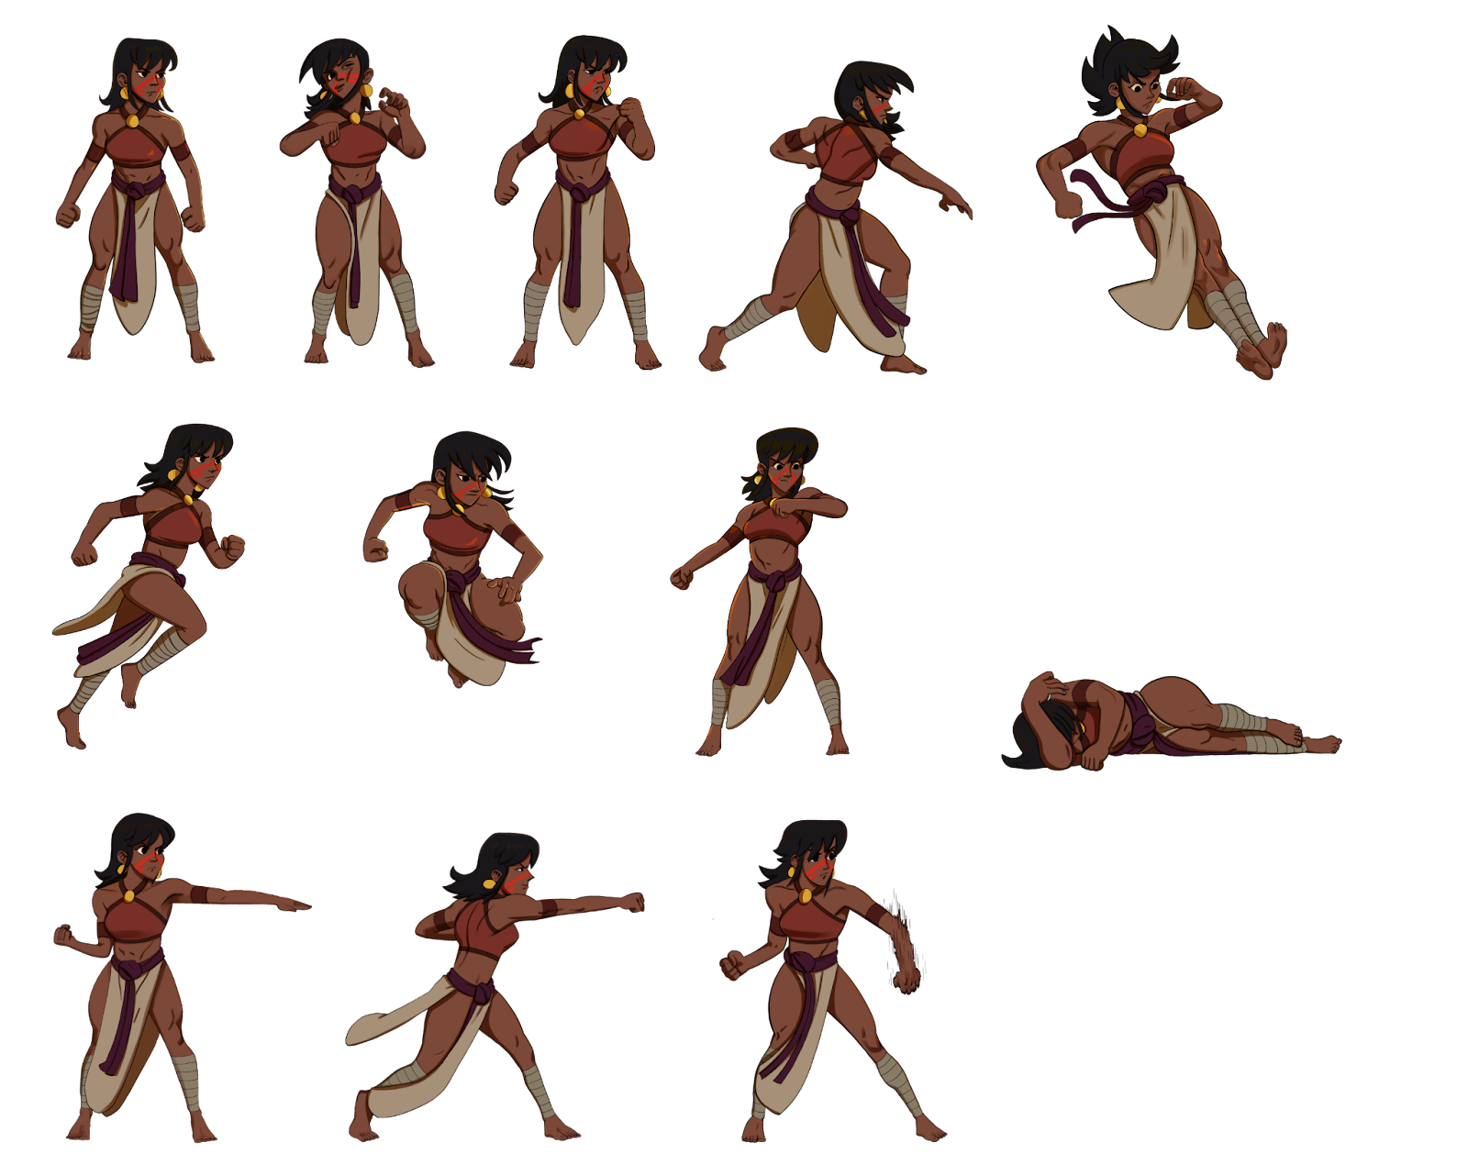
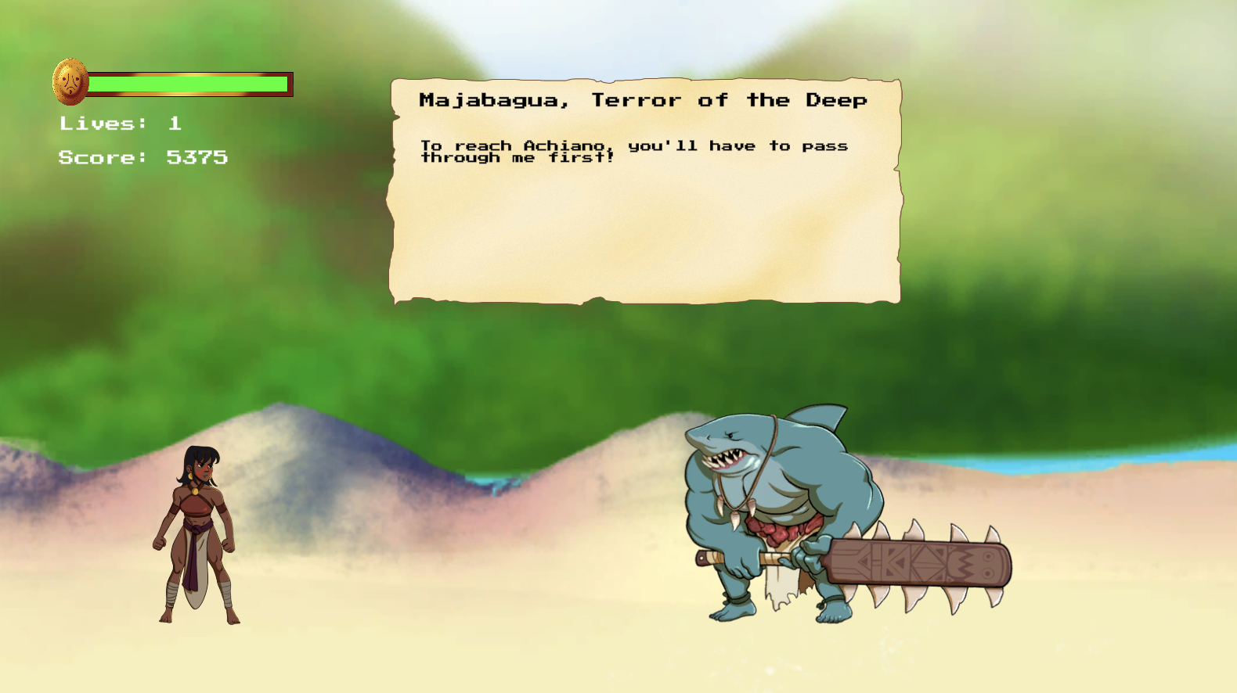
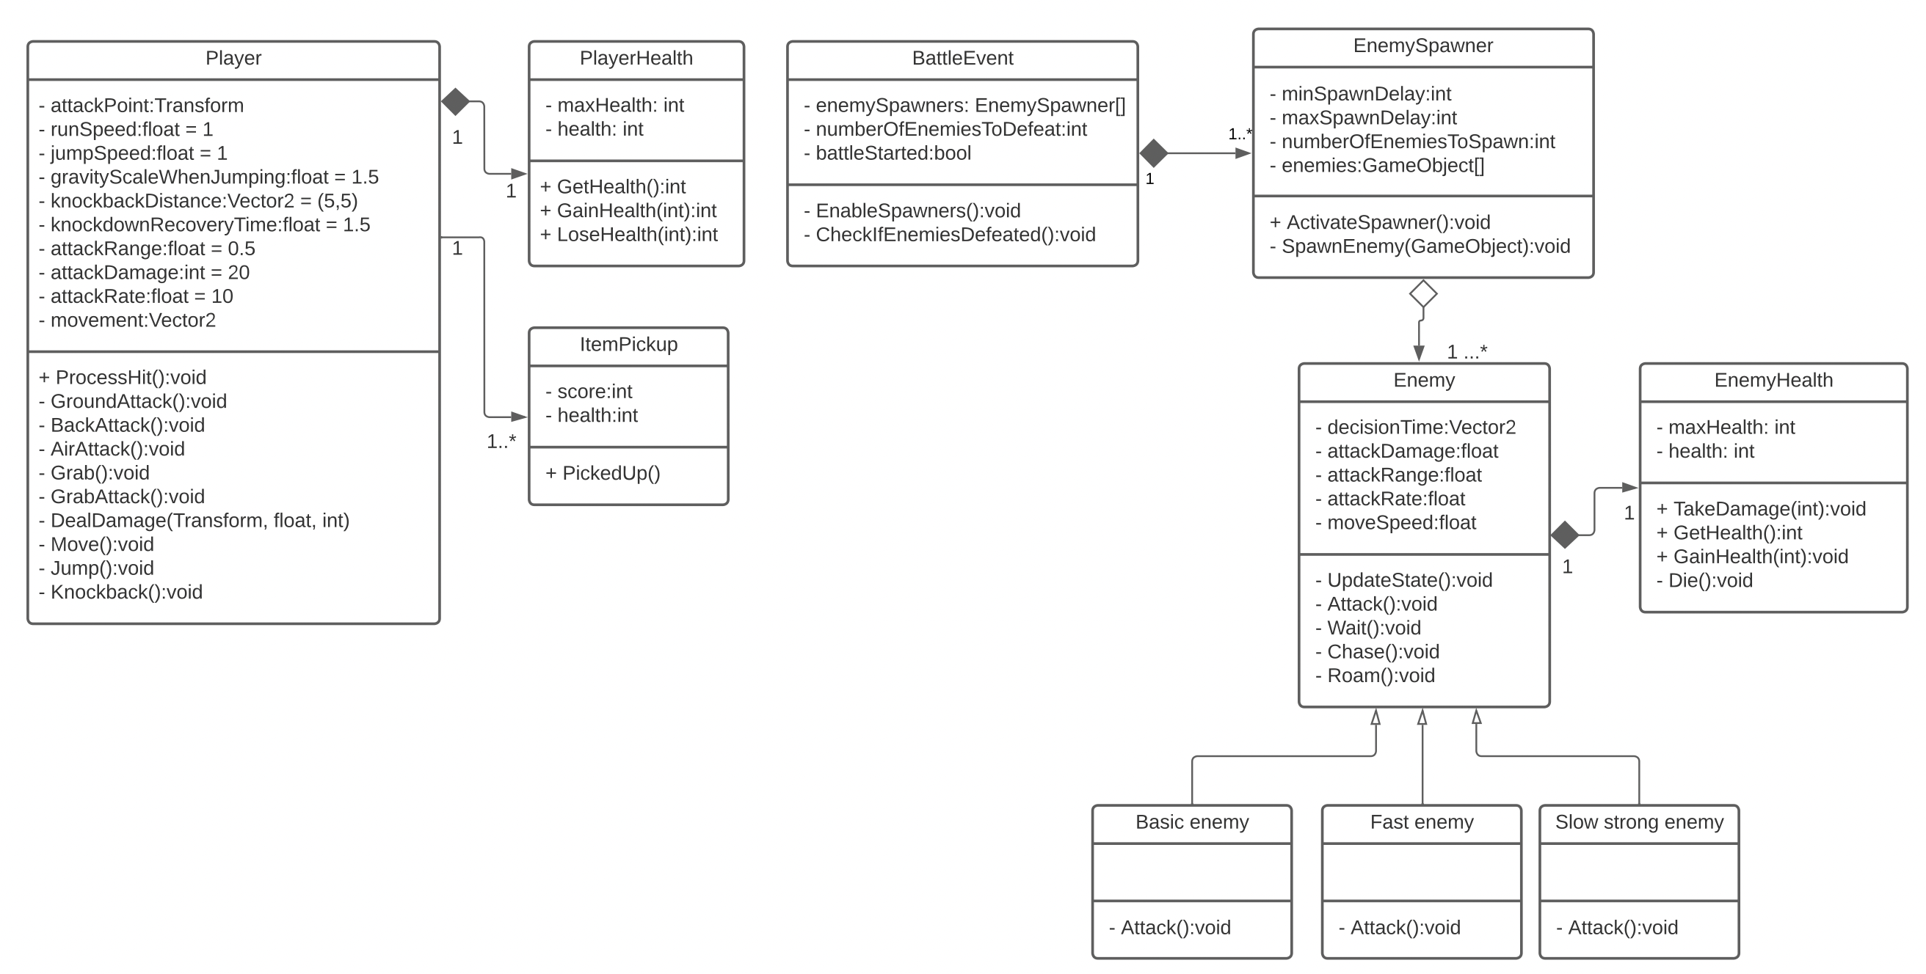
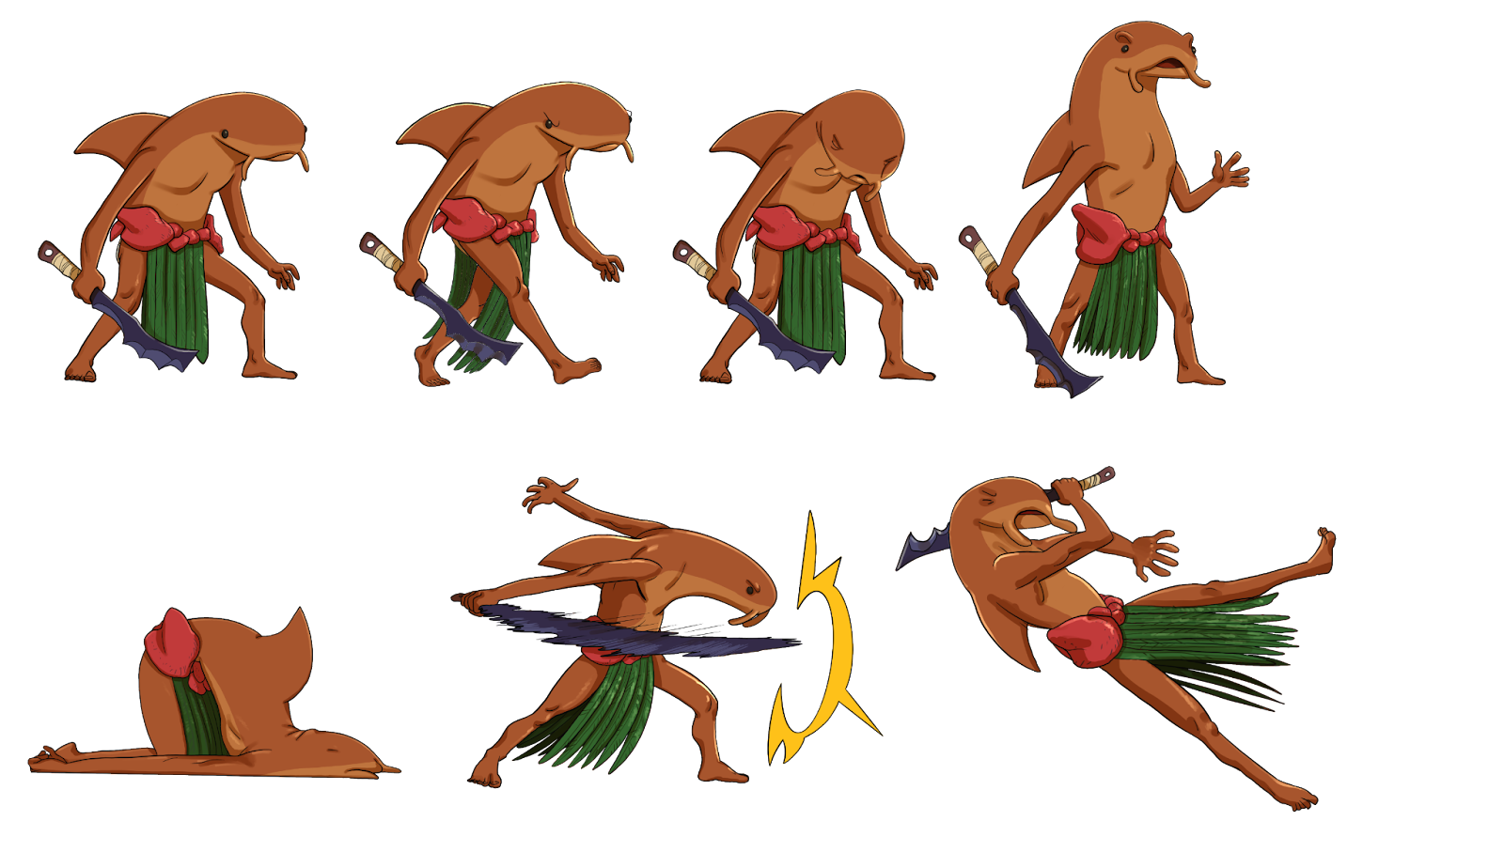
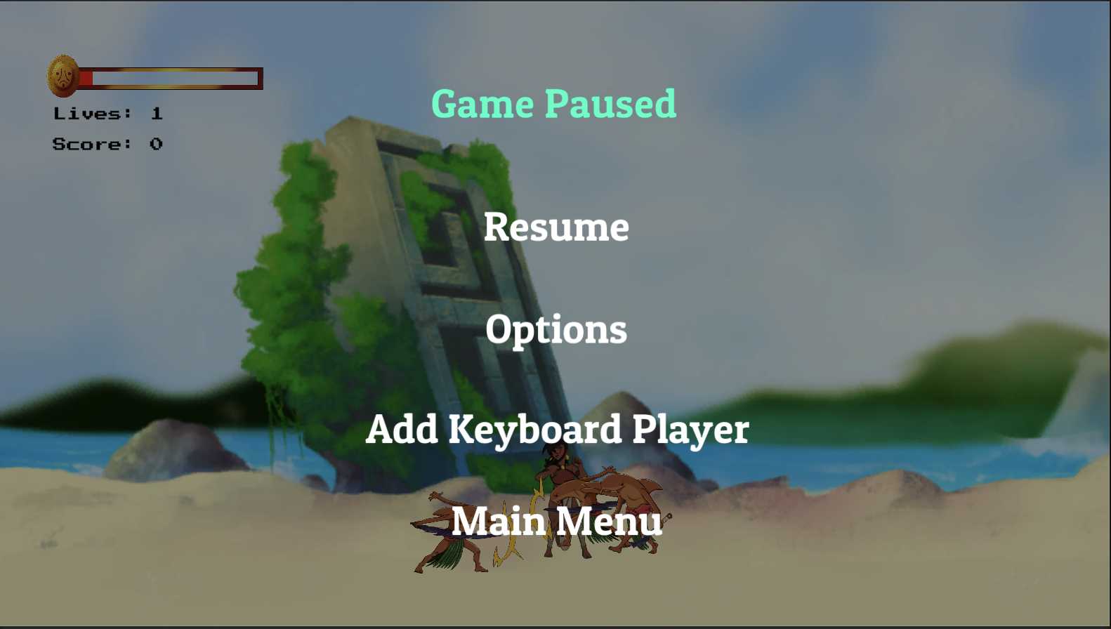
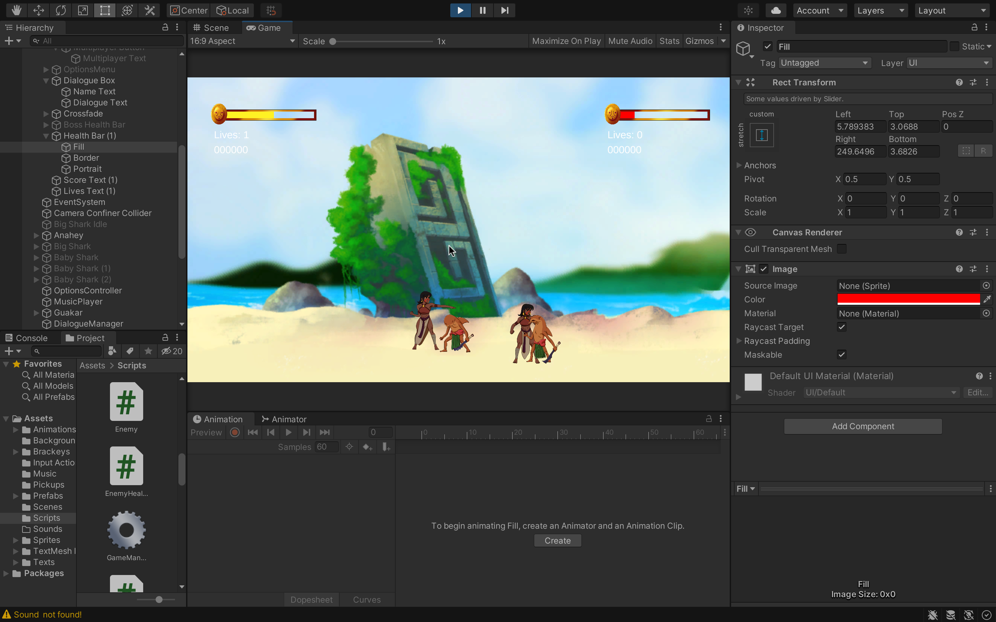
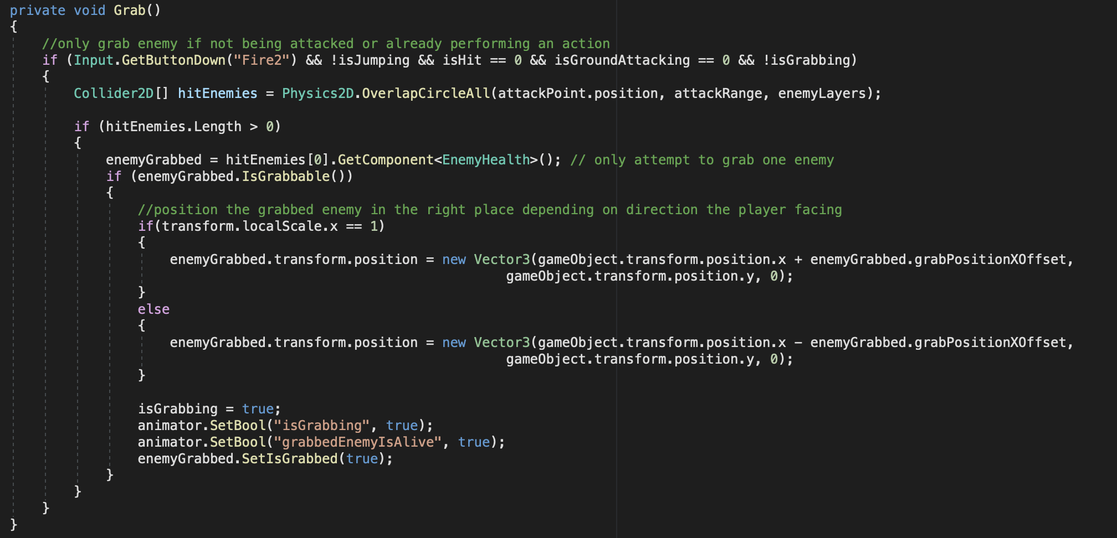
The Winds of Boriken: A Taino Fantasy Adventure
Paul Smith¹ , David Monsegur²
1. St. Mary’s University, San Antonio, TX 78228
2. The University of Texas at San Antonio, San Antonio, TX 78249
Background
Content
Design
The Winds of Boriken is an action beat ‘em up game inspired by the mythology of the indigenous people of the Caribbean, the Taíno, being developed in partnership with a local Puerto Rican artist. Fantasy stories focusing on Latino characters and mythologies are uncommon, particularly in video games. The goal of this game is to create a fun experience that can serve as a fun attention grabber to encourage players to learn more about Puerto Rico and its history. The game is embedded into a simple educational website about Puerto Rico to give players a brief introduction to the history and culture of Puerto Rico.
The Winds of Boriken is made up of four levels and a brief tutorial to teach players the controls. Players must fight through waves of enemies using a combination of ground, air, and grab attacks. Occasional boss fights introduce powerful enemies with more health and stronger attacks. Once a player completes a level, the next is unlocked on the level select screen on the main menu.
The main menu
The level select screen
Flow Chart
Concept art for The Winds of Boriken by David Monsegur
Player in dialogue before boss fight
Approach
The game was developed in C# using the Unity game engine and built as a WebGL product. It is embedded into the HTML of a simple educational website I built last semester and is playable on the Google Chrome browser by up to two players using the same keyboard. While not all the visual assets are finished, all core features of the game are complete.
Class Diagram
Ex. sprite sheets used for animating characters
The pause menu
Future Work
Aside from the addition of more enemies and levels, improvements can be made to reduce the amount of coupling between objects through an expanded use of the observer pattern using C# events. The game is also only playable using a keyboard, additional work is needed to make the product playable with gamepads and on consoles. We would also like to fully translate the game to Spanish and add more configurations for adjusting options and difficulty. There are also a ton of variables for each object that could have more time spent tuning for a better game feel.
Acknowledgements
Special thanks to Dr. Redfield for her support throughout the semester and Anthony Smith for his help on sound effects and music.
Unity Development Interface
Resources
Code for grabbing enemies
https://www.udemy.com/course/unitycourse/
https://www.udemy.com/course/the-complete-web-development-bootcamp/
https://docs.unity3d.com/Manual/index.html
https://brackeys.com/

